Slide 1
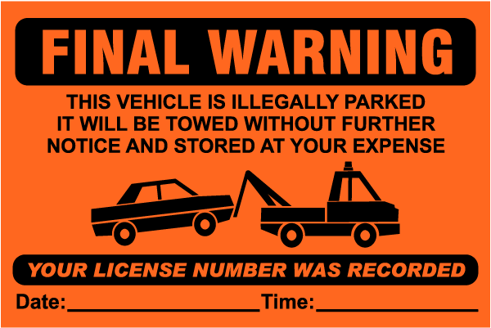
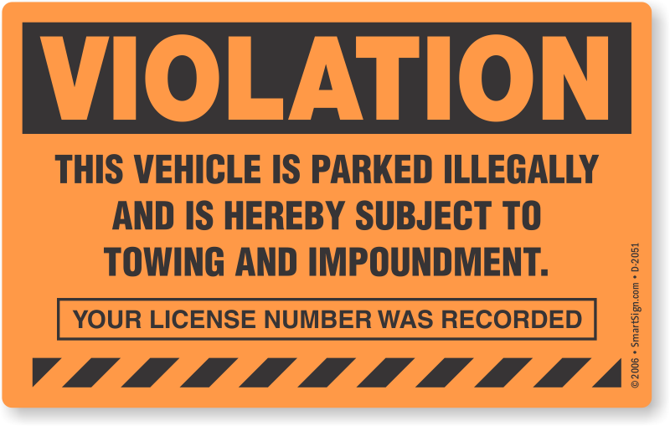
How to avoid getting Citations in LA?
Team - Yellow
Brandon, Emre, Kevin, Ujwala

Slide 2
Start with Why?
-Simon Sinek
Why LA Parking citations Dataset?
This dataset has multiple variables that we can study and find different trends in.
It’s a big Dataset with 9 million rows
We all want to know how to avoid getting parking citations
LA Population: 4 Million (2017)
LA Visitors count : 50 million (2018)

Slide 3
LA Parking Citations HeatMap and zip codes
Data Source
We found datasets on LA Parking Citations on Kaggle
Cleaning the data
Latitude and Longitude were incorrect
Used Pandas `.apply` and a lambda function to add “Los Angeles, CA” to address to eliminate addresses that could be in multiple places (e.g. 525 S. Main St.)
Replaced blanks with NaN’s then dropped NaN’s
Used Google Maps API to locate correct Latitude and Longitude coordinates
Also used the response to locate zip code and add it all to a new dataframe

Slide 4
LA Parking Citations HeatMap and zip codes
Analyze the Data
Created HeatMap from the address data weighted by ‘Fine Amounts’
Created City Boundary to layer with HeatMap
Bar Charts for both Fine Amounts and Fine Counts
Questions:
What areas have the highest fines?
Are the fines greater in certain areas?
Are you more likely to get a ticket in certain zip codes?

Slide 5
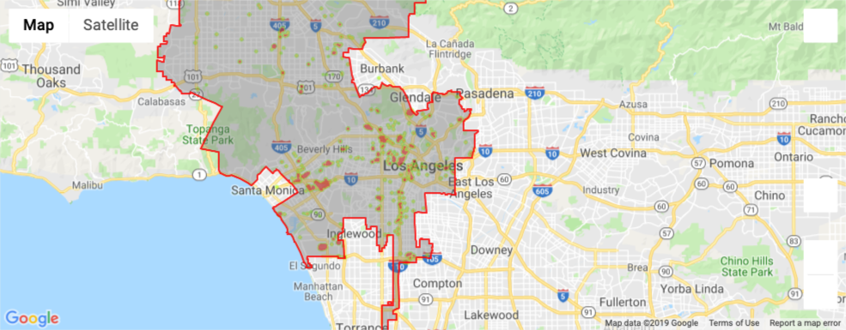
LA Parking Citations HeatMap and zip codes

Slide 6
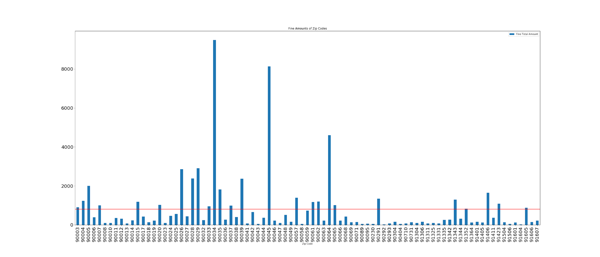
Fine Amounts of Zip Codes

Slide 7
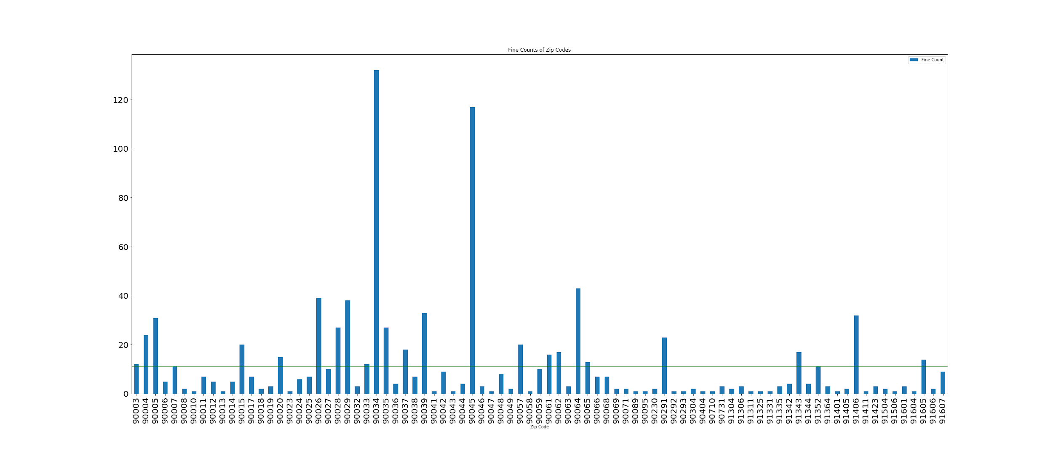
Fine Counts of Zip Codes

Slide 8
Are certain zip codes worse and therefore you are more likely to get a ticket in a zip code?
Null hypothesis: there is no statistical difference in the distribution of fines in zips codes then the distribution can be explained by random chance of the number of fines.
Critical Value: 105.27
Chi-square value: 3,090.78
Conclusion: With the chi squared value above the critical value of 105.27 We conclude the results are statistically significant. So the distribution of the frequencies of fines in zip codes is meaningful. Reject the null hypothesis.

Slide 9
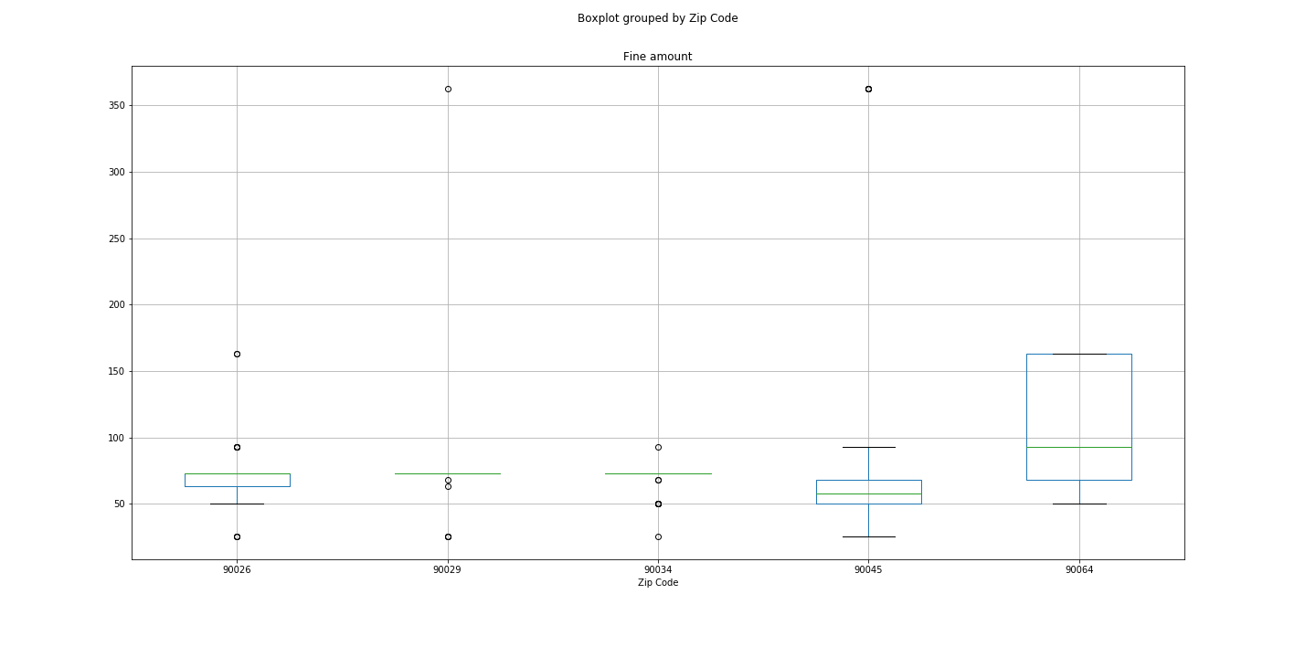
Are fines greater in certain zip codes for the top five most ticketed zip codes?
Null hypothesis: There is no difference in fine amounts of the top five zip codes. So parking in one zip code will result in the same fine if given a ticket.
Conclusion: There is a statistical difference in the zip codes for the top five for fine amounts. Reject the null hypothesis.

Slide 10
Cleaning LA Parking Violations and Fines
Cleaning The Data
Reduce inconsistencies in the ‘Violation Description’ column.
Tossed Non-Descriptive entries i.e. ‘22405A’
Used ‘replace’ function to simplify violations
Used ‘replace’ to correct violations spelled differently
Fines assigned to type integer
Limitations
No data is perfect. There isn’t an exact way to clean descriptive data.
How the data is cleaned can affect counts and fines are calculated
Personal choice on where to reduce and simplify or what data toss.
Concise and Clear as possible

Slide 11
LA Parking Violations and Fines
Questions:
What are the most common violations?
Which violations carry the highest fines?
Is there a correlation between violations and locations?
Analyze the Data
Created a bar chart of the 10 Most Ticketed Violations.
Created a bar chart of 10 Highest Fined Violations.
Chi-Square test on violations and locations dependence.

Slide 12
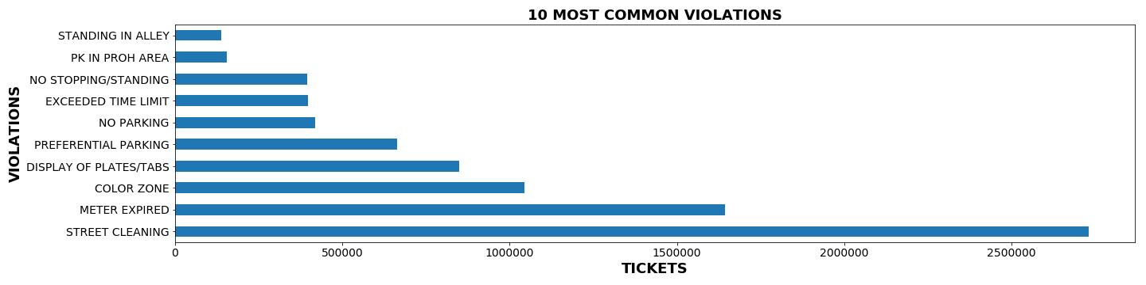
What are the most ticketed violations?

Slide 13
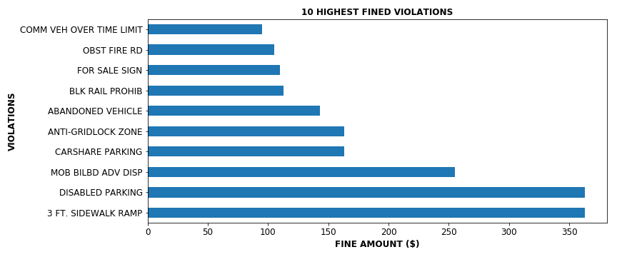
Which violations carry the highest fines?

Slide 14
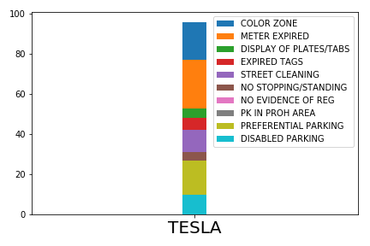
Top 10 Tesla Violations

Slide 15
Are you as likely to receive the same violation in one part of LA as you would in another?
Null hypothesis: The null hypothesis is that violations handed out are independent of LA locations.
Critical Value: 123.25
Chi-square value: 446558.37
P-Value = 0.0
Conclusion: With the chi squared value above the critical value of 123.25 and our P-Value within the confidence level, we can reject the null hypothesis. Concluding that violations vary from area to area.

Slide 16
Time and Date Analysis for LA Parking Citations:
Questions:
What time of the day more citations are given?
What day of a week more citations are given?
Are more citations issued on Weekend vs Weekday?
Data Extraction:
Created sample of approx. 47000 rows data out of 9 millions of rows from Kaggle LA Parking dataset.
Saved it into CSV file for future use

Slide 17
Time and Date Analysis for LA Parking Citations:
Data Cleansing:
Found 0.01% null values out of selected data.
Converted date and time columns to standard format
Removed unwanted columns
Created a dataframe with only columns I needed to do analysis on Ticket Number, Issue time and Issued Date.
Data Manipulation:
Used Datetime, calendar and holiday module to manipulate Date and issued time columns.
Extracted date, Weekday, Month and year out of standard YYYY-DD-MM format.
Data Visualization:
Used Bar graphs, Heat map to Visualize the findings over the time and date relation with citation count.
Used dataframe to convert the calculated results into table format.

Slide 18
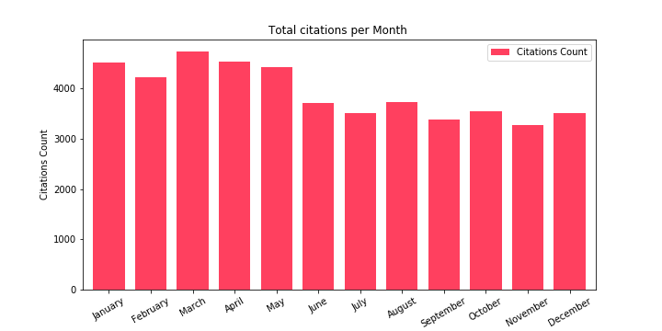
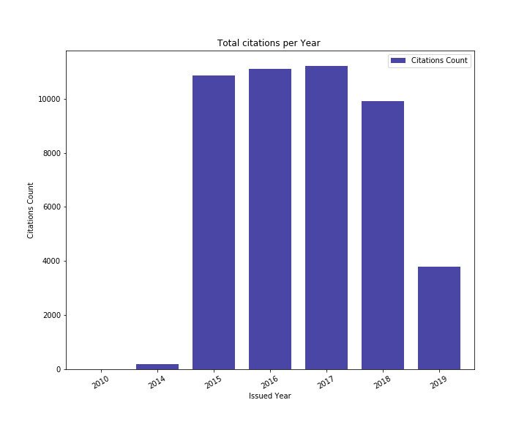
Is issuing Citations have increased over the years??
The Total citation per year bar graph shows that for year 2015 the citation count has increased almost 90% and have been decreased by 10% in 2018.
The Total Citations bar graph shows that almost every month there have been more than 3000 citations issued but , Max citations have issued in March and April months compared to others.

Slide 19
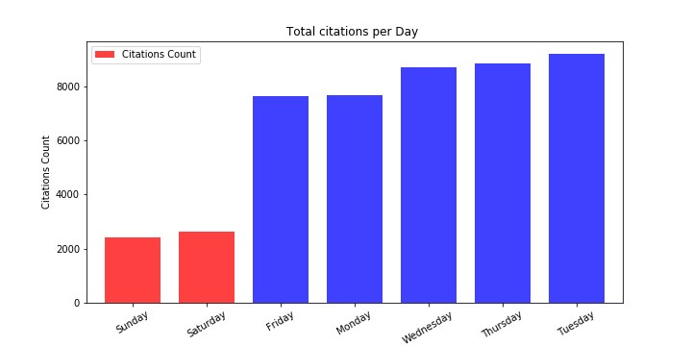
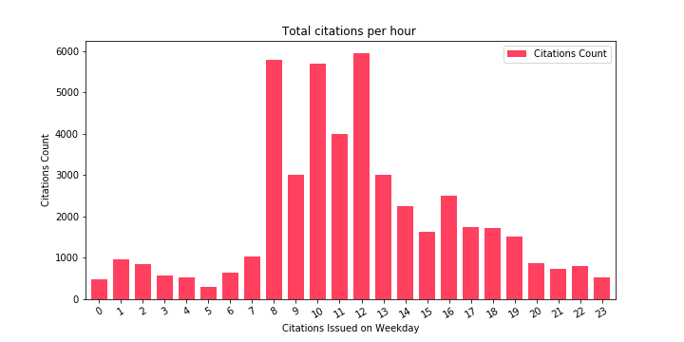
Which Day and hour has more Citations issued on??
More citations have been issued in mid week compared to weekends.
Weekend Citation rate is significantly low than weekdays.
More Citations have been issued at 8 Am, 10 Am and 12 pm compared to rest of the day

Slide 20
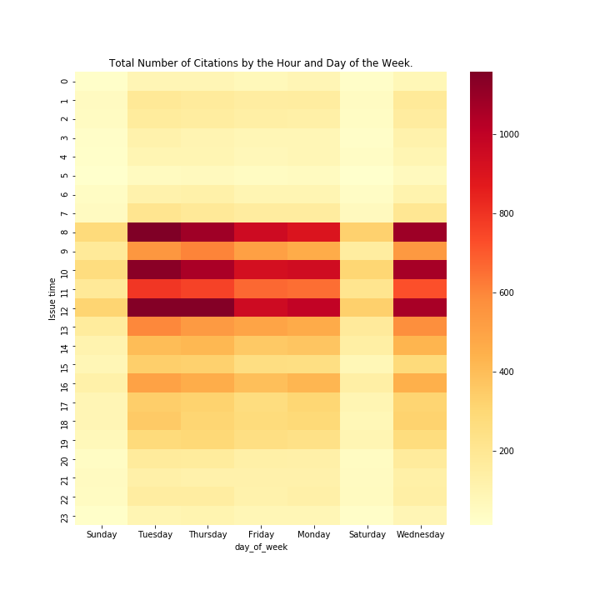
Citation variation by time and day of the week.
This Heat Map clearly shows the maximum citations have been issued on Tuesday, Wednesday and Thursday at 8 am, 10 am and 12 pm.

Slide 21
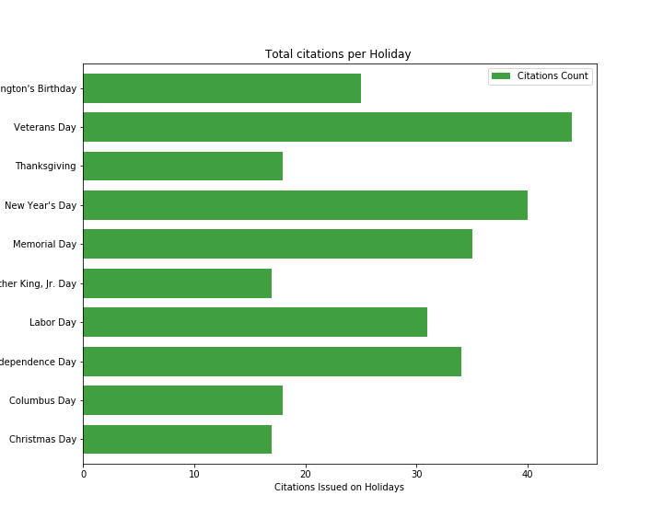
Citations issued on Holidays.
The bar graph shows us Maximum citations have been issued on Veterans day and New years day holidays.
Avg Daily Citations: 6724.0
Avg Holiday Citations 27.9

Slide 22
Any Questions?
We hope our analysis will give you some insight on how to avoid getting parking citations when you visit LA next time.

